Slide 1
Tableau Project
File created on: 10/19/2022 2:31:46 AM

Slide 2
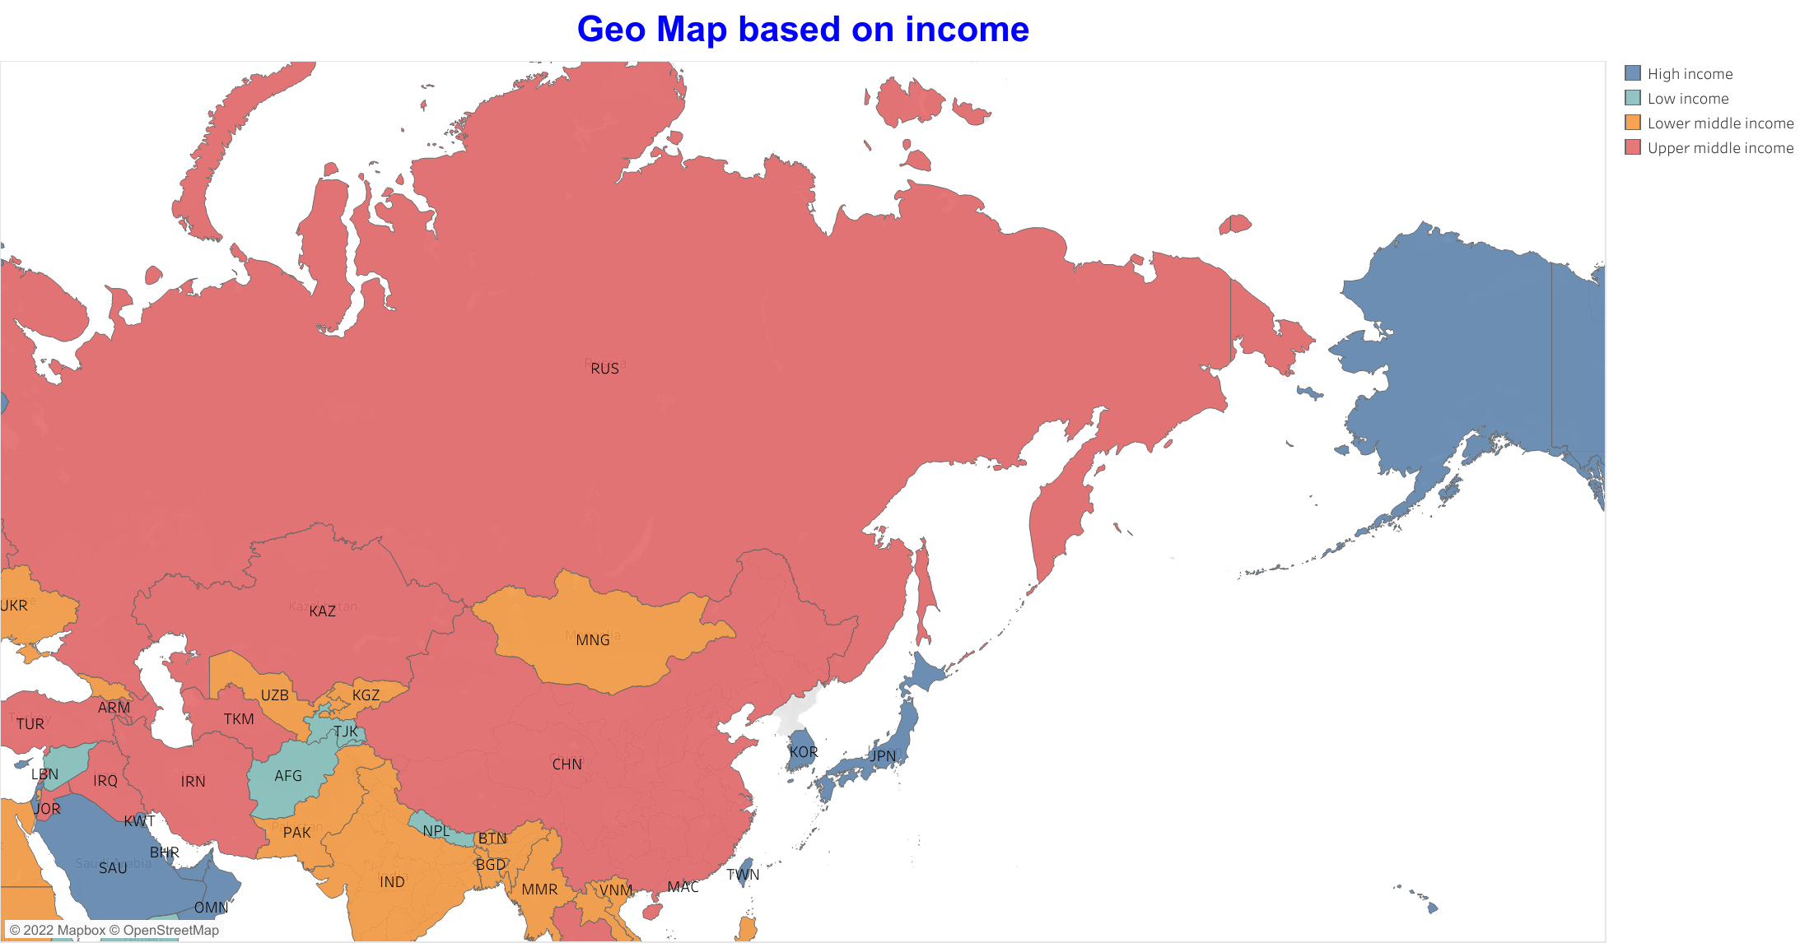

Slide 3
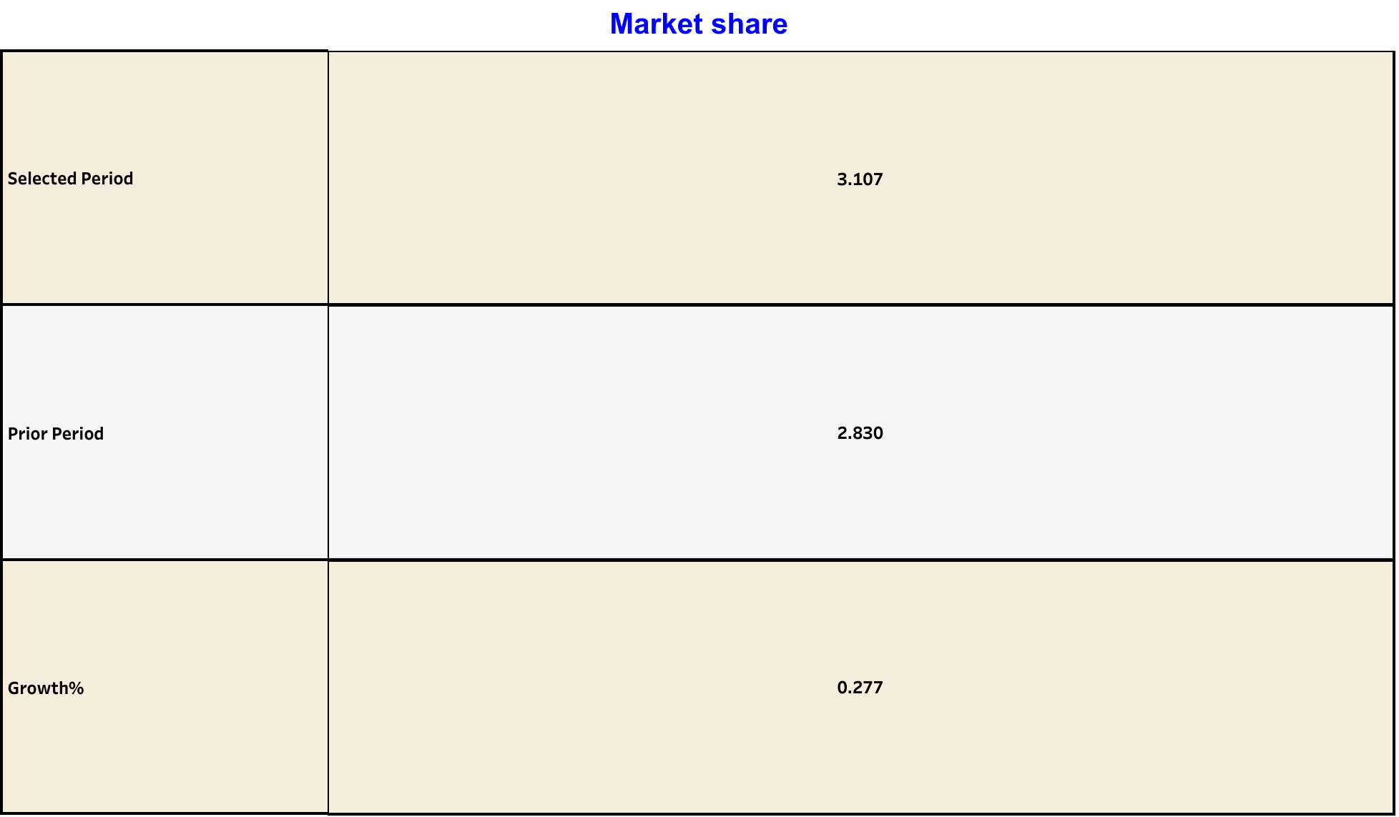

Slide 4
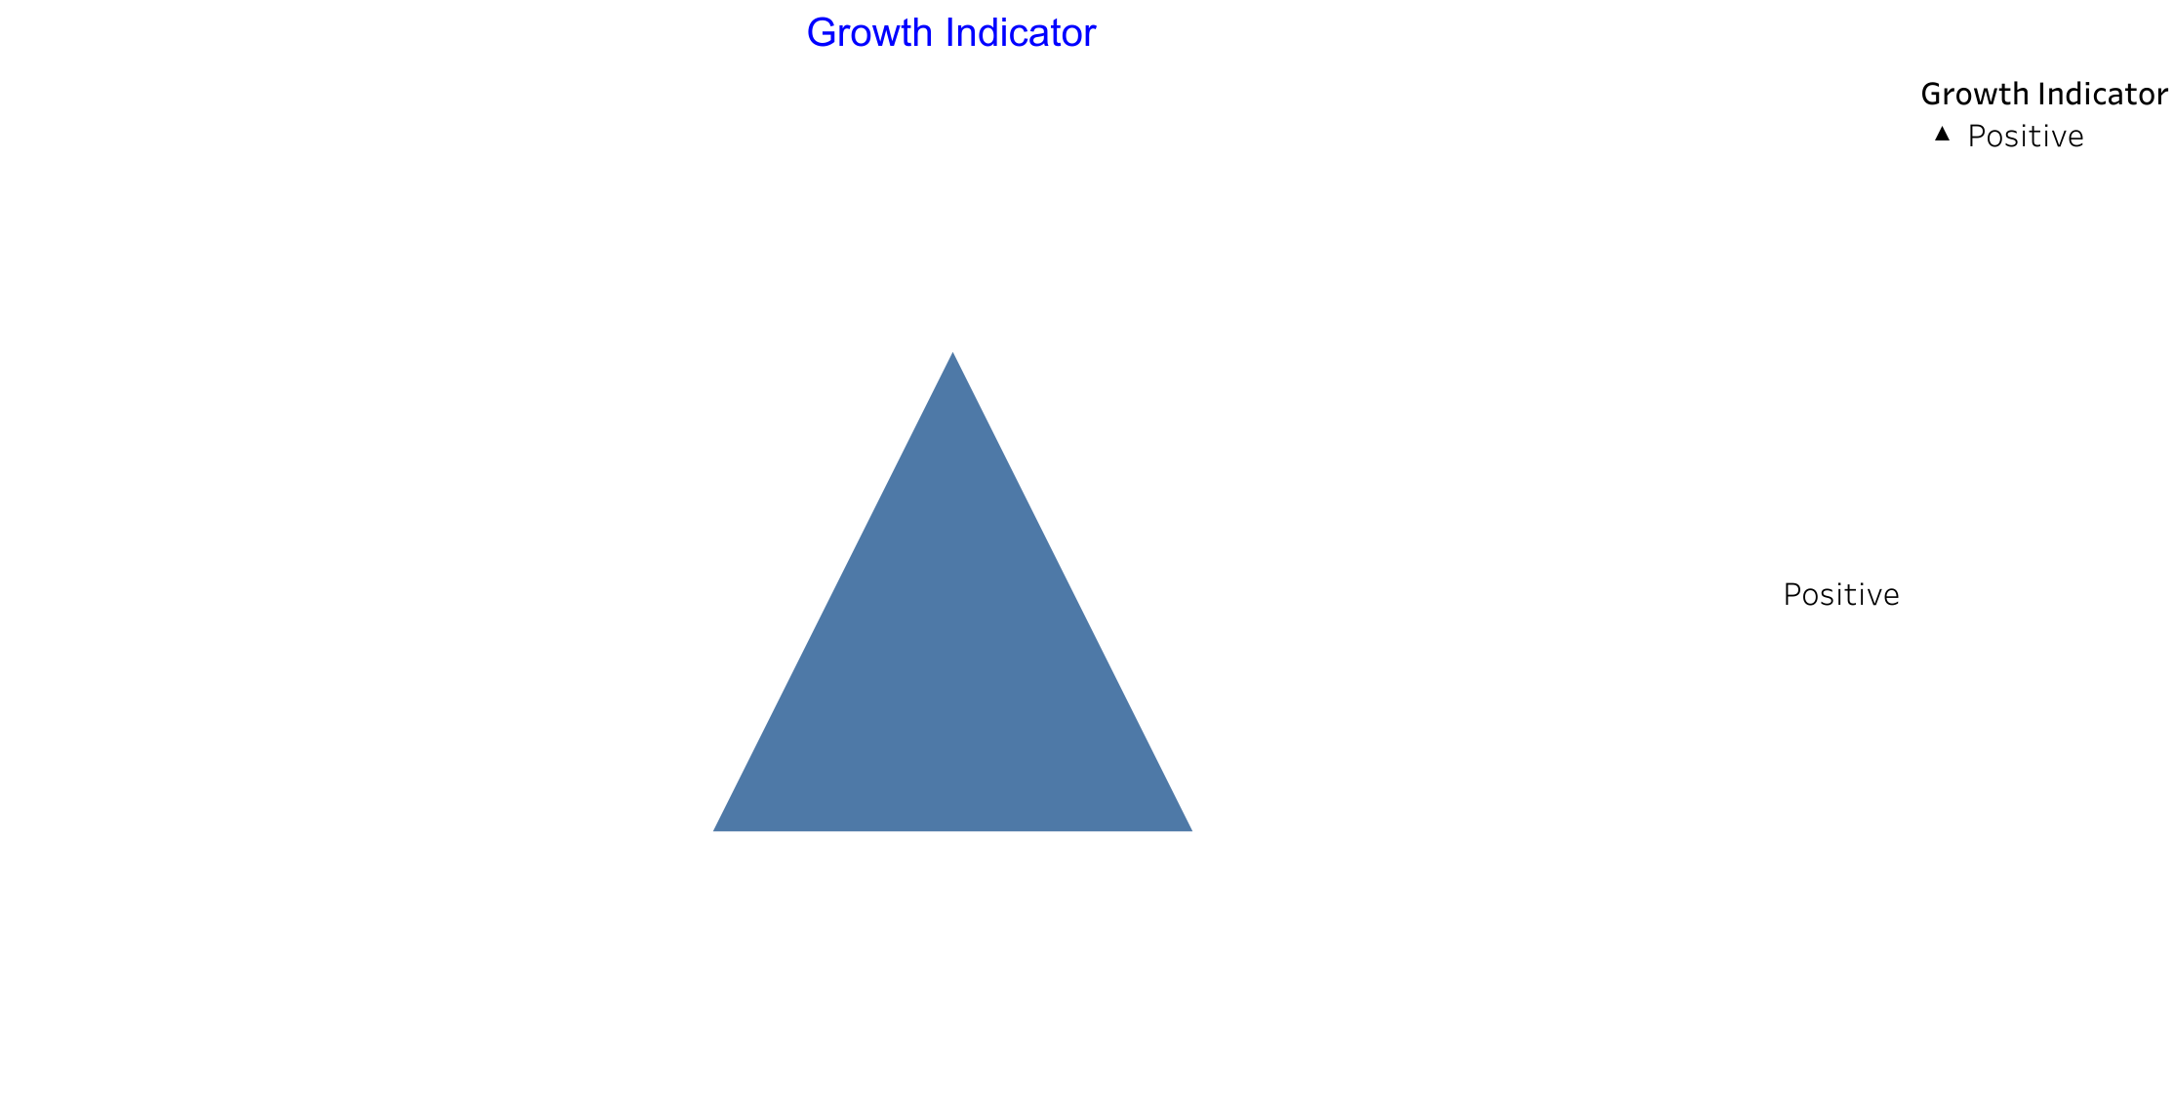

Slide 5
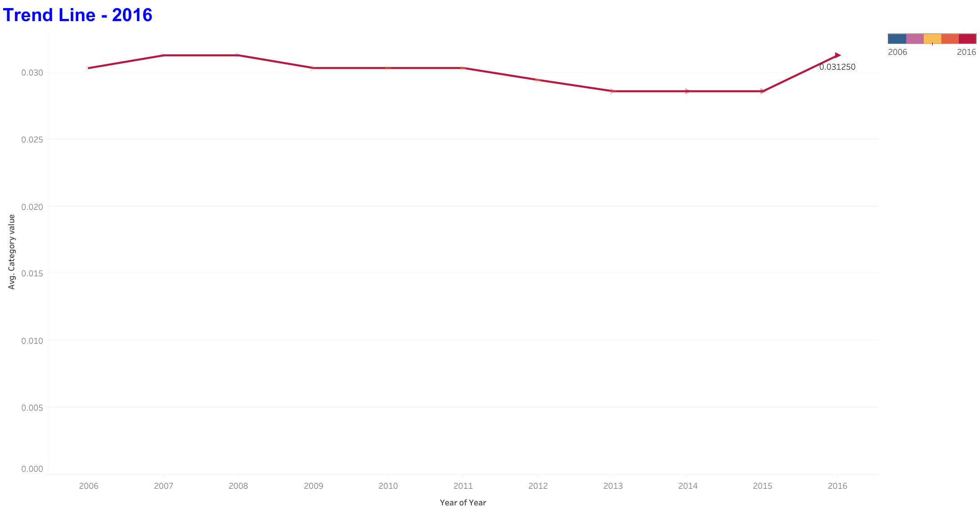

Slide 6
